Slide 1
From DataCenter to
Cloud: Automating F5
Big-IP with Terraform
Muhammad Shoaib

Slide 2



Muhammad Shoaib
Director of Edge and Infrastructure Security
Paciolan is your one-stop shop
For ticketing, fundraising, marketing solutions and customer engagement

Slide 3
Data Center Architecture
WAF
Cisco / Palo Alto
F5 BIG-IP pair
EKS
App1
Web Farm
App2
ECS
App3

Slide 4
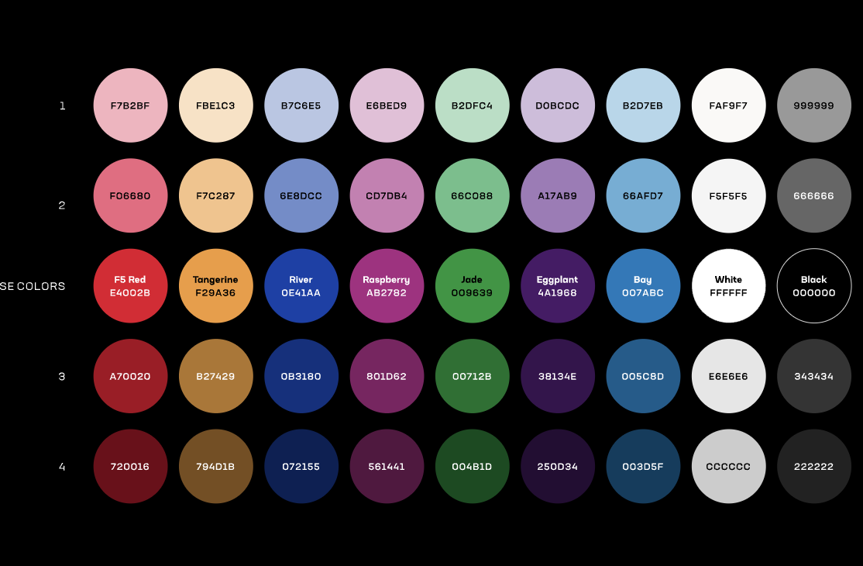
Cloud Architecture
CloudFront
AWS WAF
Origin
Origin Group VPC Origin
nlb-1
Target group
nlb-2
Target group
F5 BIG-IP-1
Virtual
F5 BIG-IP-2
Virtual
EKS
App1
Web Farm
App2
ECS
App3

Slide 5



Prerequisite
F5 Reg key
BIG-IP VE AMI
AWS account
VPC
SSH Key Pair
3 subnets
Security group
Terraform

Slide 6
The Phases - Launch VE
Launch BIG-IP AMI as EC2
Create 3 interfaces
Create Secondary IP for BIG-IP VIP
Reset admin password
Phase 1
Install license
Disable setup utility
LTM Resource Provision
Meta Data for Phase 2

Slide 7
The Phases - Networking
Create VLANs
Phase 2
Create self IPs
Add default route
Meta Data from phase 1

Slide 8
The Phases – Virtuals / Pools
Launch BIG-IP AMI as EC2
Create nodes
Create monitor
Create pools
Create profiles
Phase 3
Create DataGroups
Create virtual
Create iRule
Meta Data from phase 1

Slide 9
Phase - 1 Launch VE

Slide 10
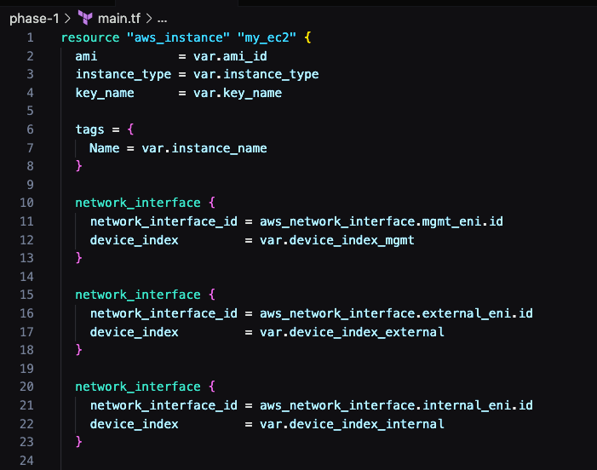
Launch BIG-IP AMI as EC22
3 Interfaces
Management
External
Internal

Slide 11
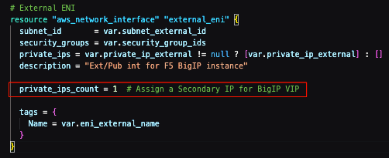
ENIs
ENIs
3 Self IPs
Management
External
Internal
IP for a Virtual

Slide 12
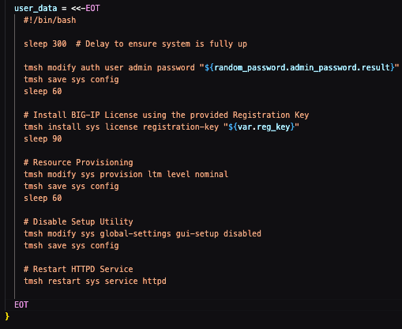
user_data
Password reset
Install license
Disable setup
Resource provision
Meta Data for phase 2 & phase 3

Slide 13
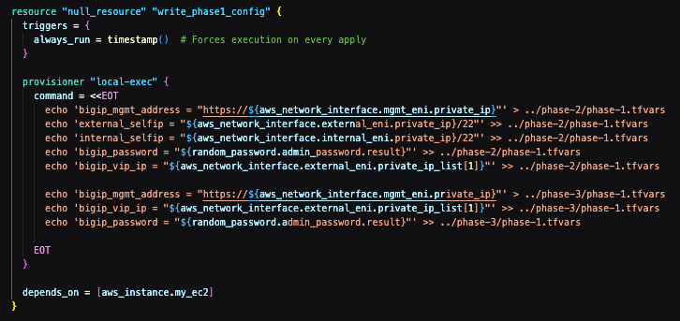
Phase - 1 Meta Data
MGMT IP
Self IPs
Admin password
VIP IP

Slide 14



Phase - 1 execution

Slide 15
Phase - 2 Networking

Slide 16
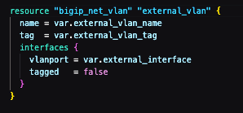
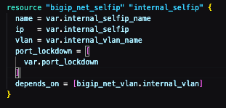

Networking
VLANs
Self IPs
Route

Slide 17
Phase - 2 execution

Slide 18
Phase - 3 BIG-IP Config

Slide 19
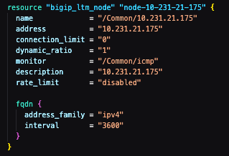
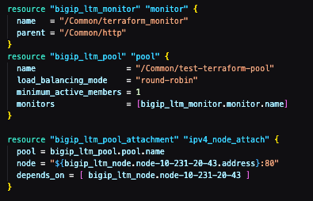
Config
Nodes
Monitor
Pools

Slide 20


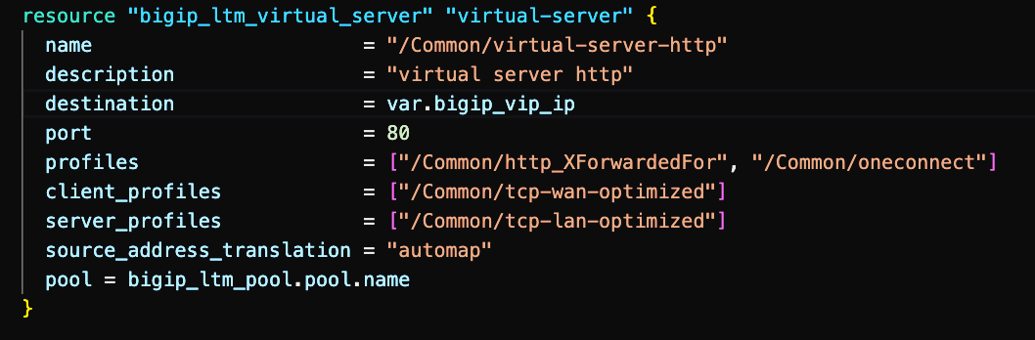
Config
Profiles
iRules
Virtuals

Slide 21
Phase - 3 execution

Slide 22
What’s next

Slide 23



Cloudfront
VPC Origin
VPC Origin
Origin
NLB
NLB
BIG-IP
BIG-IP

Slide 24

Q &A Thank you

Slide 25
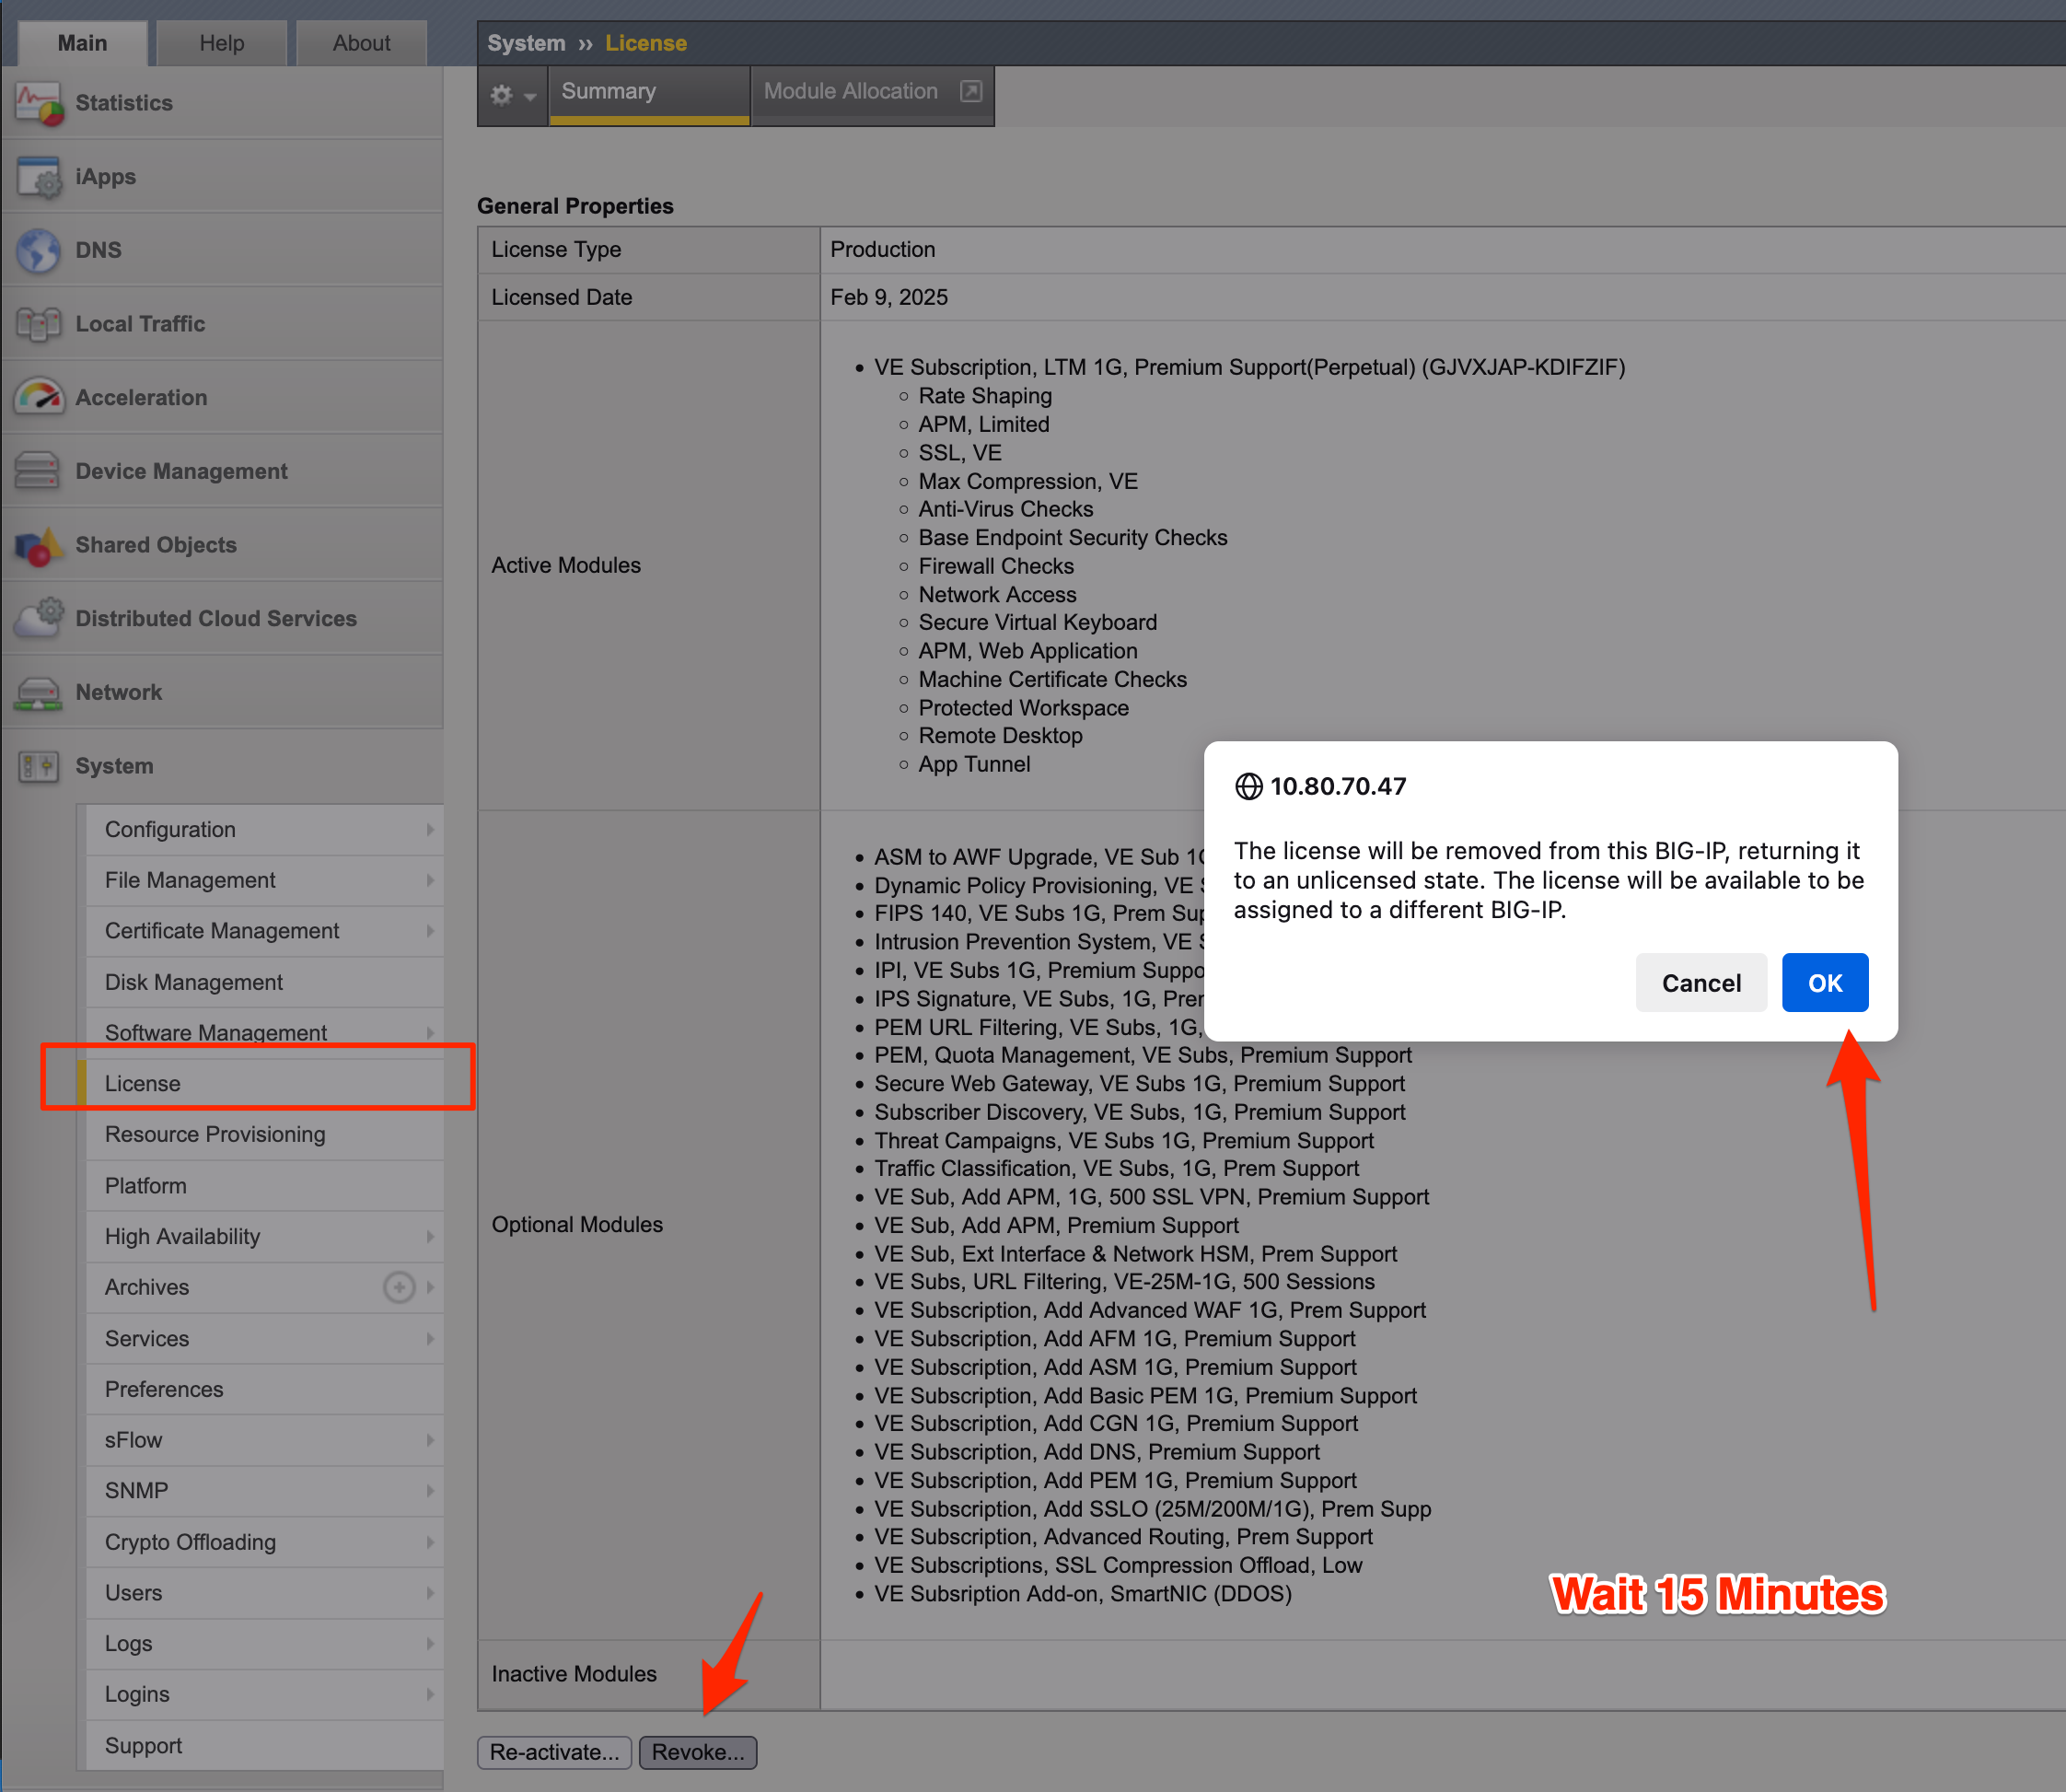
How to Revoke a License
System >> License
Revoke
Wait 15 Mins

Slide 26

https://github.com/mshoaibshafi/f5appworld25
Link

